Slide 1
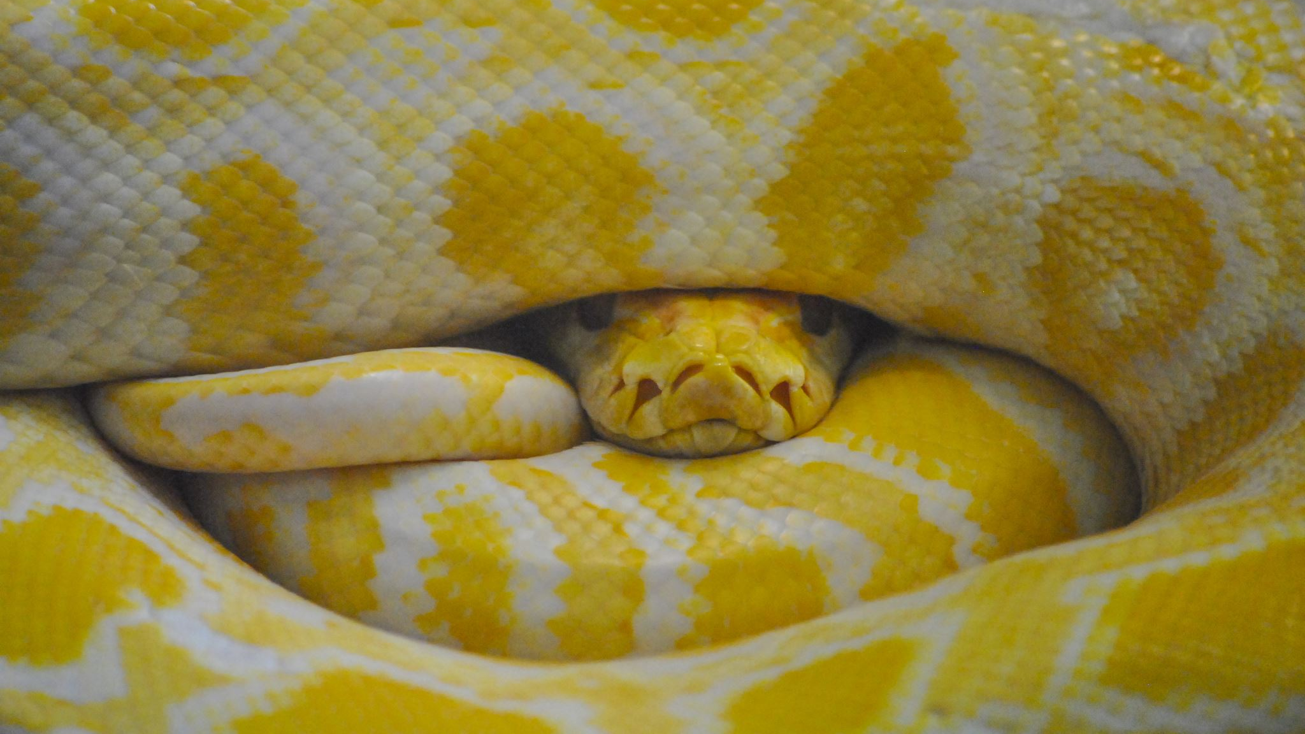
History, features and application of Python
By Aidan Fearn

Slide 2
What is Python?
General purpose programming language
Easy readability
Versatile
Interactive

Slide 3

History of Python
Python 0.9.0 released February 20th 1991
Guido van Rossum
Founded in the Netherlands
Development started in December of 1989
Many core features used today were applicable in early beta testing and development

Slide 4
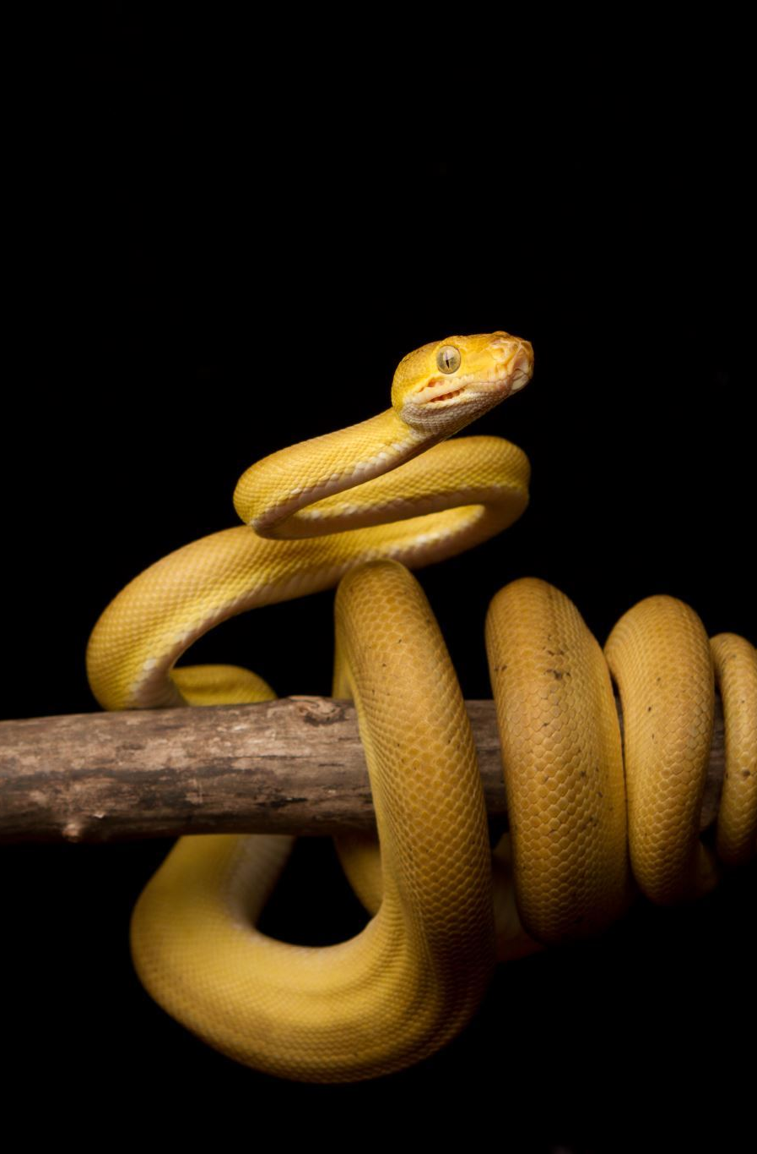
Evolution of Python
Origin (Late 1980s)
Python 1.0 (January 26, 1994)
Python 2.0 (October 16, 2000)
Python 3.0 (December 3, 2008)
The Split (Python 2 vs. Python 3)
Python Software Foundation (PSF)
Python 2 End of Life (January 1, 2020)
Recent Developments (Beyond 2020)

Slide 5

The Split (Python 2 vs. Python 3)
The release of Python 3.0 led to a period of coexistence with Python 2.x, as some developers continued to use the older version due to the backward incompatibilities. This split in the community lasted for several years.

Slide 6
Python Software Foundation (PSF)
In 2001, the Python Software Foundation was established as a non-profit organization to promote, protect, and advance the Python programming language.

Slide 7
Python 2 End of Life (January 1, 2020)
The Python development team officially ended support for Python 2 on January 1, 2020. This marked the conclusion of the transition period, and developers were encouraged to migrate their code to Python 3.

Slide 8
Recent Developments (Beyond 2020)
Python continues to evolve with regular releases. The development community focuses on improving performance, introducing new features, and addressing user needs.

Slide 9
The Application of Python
Developing websites and software
Task automation
Data analysis
Data visualization

Slide 10
Sources
https://www.futurelearn.com/info/blog/what-is-python-used-for
https://pythoninstitute.org/about-python#:~:text=Python%20was%20created%20by%20Guido,called%20Monty%20Python's%20Flying%20Circus.
https://cointelegraph.com/news/history-of-python-programming-language

